Slide 1
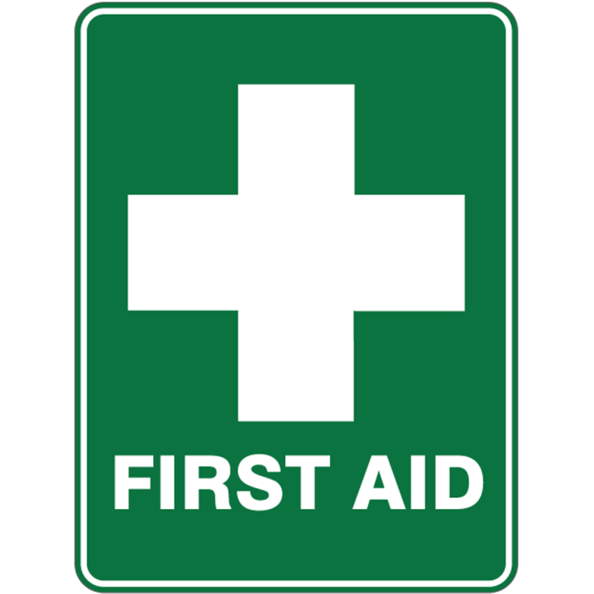

Slide 2
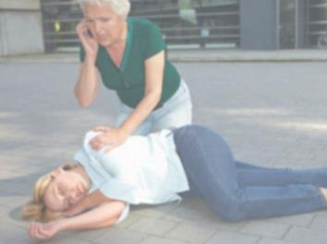

WHAT IS VASO VAGAL
Heart rate slows
Blood pressure drops
Lack of blood to the brain
Causes confusion
Slows down pulse rate
Also referred to as fainting
VASO VAGAL

Slide 3
WHAT CAN CAUSE VASO VAGAL
Dehydration
Low blood sugar (e.g. not eaten)
Anxiety
Alcohol use
Medications (e.g. Codine)
VASO VAGAL

Slide 4
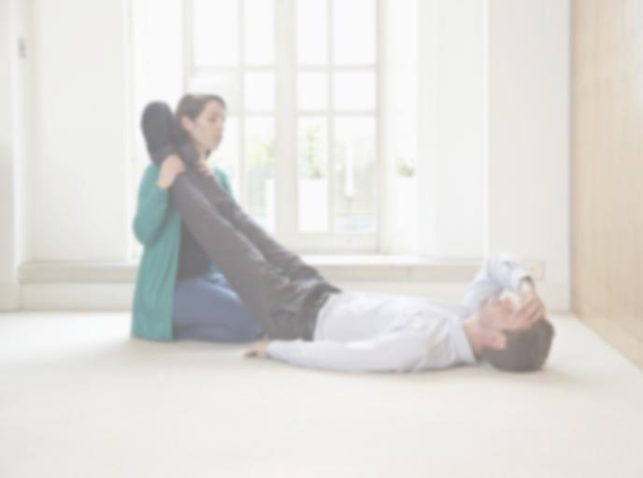
Q.
ACTIONS FOR A VASO VAGAL EPISODE?
Recognise the signs of a vasovagal attack
Guide them to the floor
Raise their legs
Place them in the recovery position if they are unresponsive
If they stop breathing, perform CPR
VASO VAGAL

Slide 5
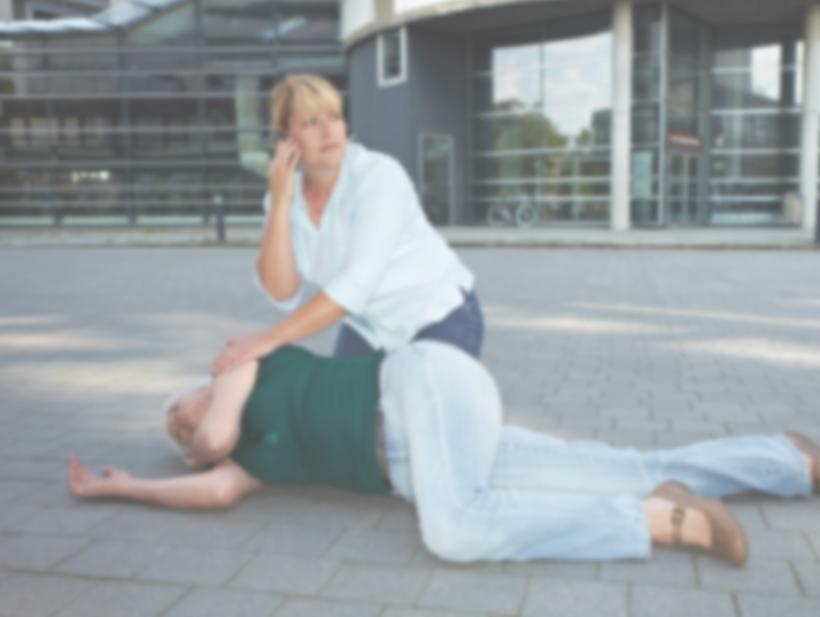
Q.
HOW WOULD YOU PLACE SOMEONE IN THE RECOVERY POSITION?
Chin lifted to keep airway clear
Raise the knee to 90° and roll client towards you
Hand underneath face supports head
Knee forward stops body from rolling onto stomach
RECOVERY POSITION

Slide 6
CLICK HERE: BREATHING BUT UNRESPONSIVE VIDEO

Slide 7
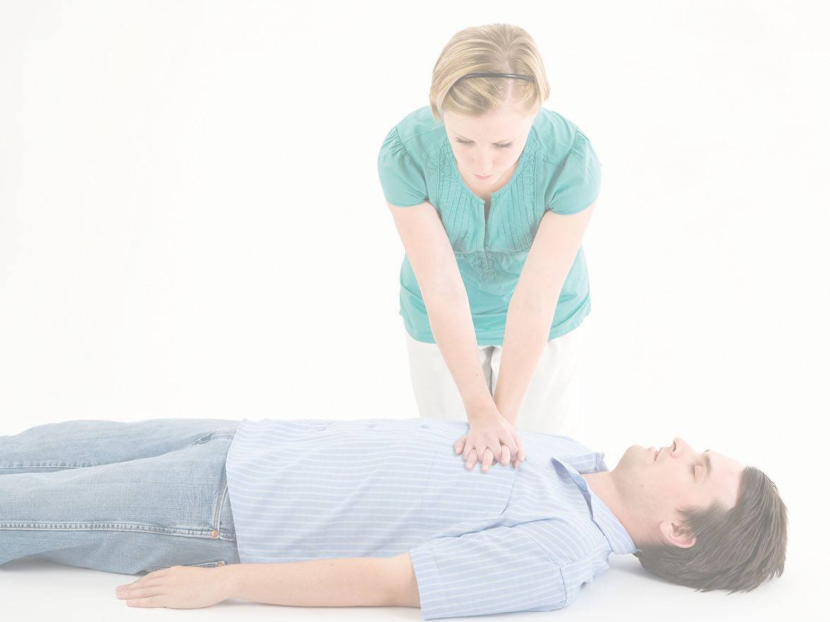
Q.
HOW WOULD YOU PERFORM CPR?
CPR stands for Cardio Pulmonary Resuscitation
Assess the situation – ensure there are no hazards
Check for a response using simple commands
If no response call for an ambulance
Begin CPR (30 chest compressions: 2 rescue breaths)
Repeat as much as you can until emergency help arrives
CPR

Slide 8
CLICK HERE: UNRESPONSIVE AND NOT BREATHING VIDEO
CPR

Slide 9
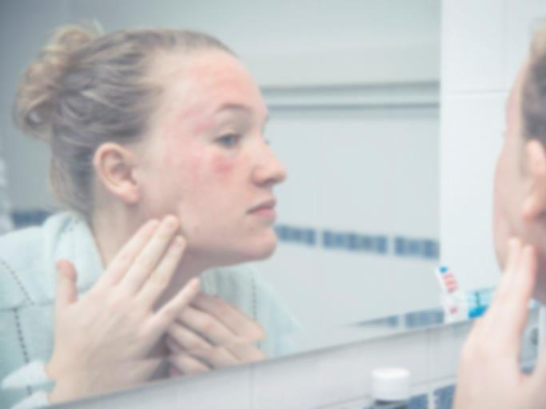
WHAT IS ANAPHYLAXIS
Severe allergic reaction that is potentially life-threatening
Airway can become blocked resulting in breathing and swallowing difficulties
Circulation problems and swelling
Skin and/or mucosal changes
Recognise the signs and symptoms of anaphylaxis so you can act quickly
ANAPHYLAXIS

Slide 10
Q.
WHAT CAN CAUSE AN ANAPHYLAXIS?
Nut / Food
Latex
Lidocaine
Bee / Wasp Stings
Pigment Products
Medications
Fish / Fish Oil
Pets
ANAPHYLAXIS

Slide 11
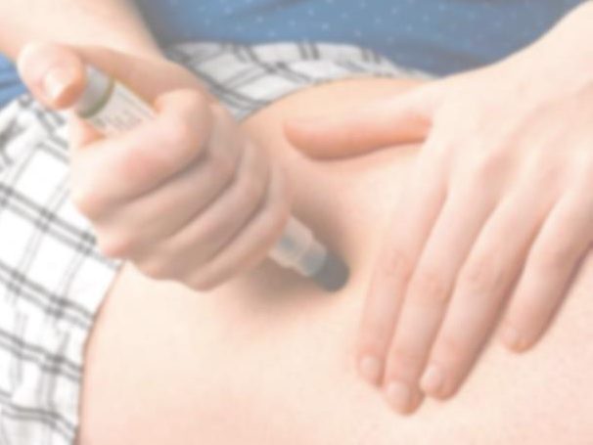
ADRENALINE PEN
An adrenaline pen releases adrenaline into the muscle
Adrenaline constricts blood vessels to increase blood pressure
Relaxes and smooths muscles in the lungs to reduce wheezing
Improve breathing
Increases heart rate
Works to reduce hives and swelling that may occur around the face and lips
ANAPHYLAXIS

Slide 12
Q.
HOW TO ADMINISTER AN ADRENALINE PEN?
Assess the situation
Call 999
Ask the operator for permission to administer the adrenaline pen
Once permission is granted, insert the adrenaline pen into the thigh (IM = IntraMuscular)
Stay with them and monitor their condition (until help arrives)
If they become unresponsive but breathing, place them in the recovery position
If they stop breathing, begin CPR
ANAPHYLAXIS

Slide 13
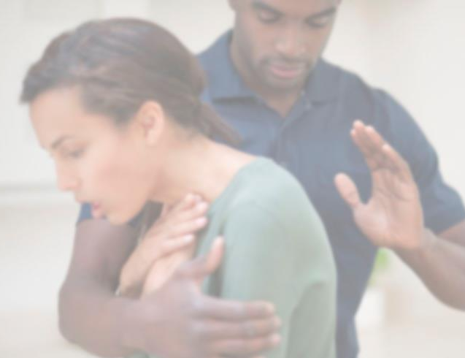
SIGNS OF CHOKING
Airway obstruction by a foreign body
Commonly occurs whilst eating
Clutching of the neck
Face and/or lips turning blue
Unable to speak, breathe easily or cough
Sense of panic
CHOKING

Slide 14
Q.
WHAT WOULD YOU DO IF SOMEONE WAS CHOKING?
Ask them “are you choking?”
Ask them to cough
Place your hand in front of them and give 5 back blows between the shoulder blades using the heel of your hand
If the obstruction remains and they are still choking, perform 5 abdominal thrusts
CHOKING
Notes:
- ASK THE QUESTION AND DISCUSS WHAT STUDENTS THINK.
- CLICK TO REVEAL HOW TO HELP SOMEONE WHO IS CHOKING
If you notice somebody is choking, encourage them to cough. If this is unsuccessful, do as follows:
If the client has gone unconscious and is not breathing, begin CPR
If the client is conscious and is still choking, administer 5 back blows:
Support their body with one arm in front of them and with the heel of your other hand, administer back blows between their should blades making a ‘J’ shape
Repeat 5 times
3. If the obstruction still remains and the client is still choking, perform abdominal thrusts:
- Stand behind the client
- Link your hands between their tummy button and the bottom of their chest, with your lower hand clenched in a fist
- Pull sharply inwards and upwards
- Repeat 5 times
4. If after 5 abdominal thrusts the obstruction still remains, repeat 5 back blows

Slide 15
CLICK HERE: CHOKING VIDEO

Slide 16

BLEEDING
Light external bleeding: Abrasions, grazes, puncture wounds and scratches
Heavy external bleeding can occur if a large vein or artery is punctured
The client can become pale, cold, sweaty
They can have a vaso vagal attack due to a drop in blood pressure
EXTERNAL BLEEDING

Slide 17
Q.
HOW WOULD YOU DEAL WITH EXTERNAL BLEEDING?
Assess the situation and ensure there are no hazards
Apply pressure to the wound to stop or slow down the flow of blood
Call 999 as soon as possible if the bleeding is heavy
Keep pressure on the wound until help arrives
Report all accidents in your Accident Report Book
EXTERNAL BLEEDING

Slide 18
CLICK HERE: EXTERNAL BLEEDING VIDEO

Slide 19

HOW TO IDENTIFY AN EYE INJURY
Constant flow of tears
Cuts or grazes of the eye
Foreign object in the eye
Pain in and/or behind the eye
Eyelid spasms
Altered Vision
Blood or a clear fluid leaking from the eye
EYE INJURY

Slide 20
Q.
WHAT SHOULD YOU DO?
Ask your client not to touch their eye
Ask them to rest in a comfortable position with their eyes closed and avoid movement of the head
Flush the eye with clean running water
Protect the injured eye with a clean eye pad
If there is a foreign body in the eye, do not attempt to remove it – pad around it to release pressure on the eye
If there is serious injury, call 999
EYE INJURY

Slide 21
ANY QUESTIONS?

